Slide 1
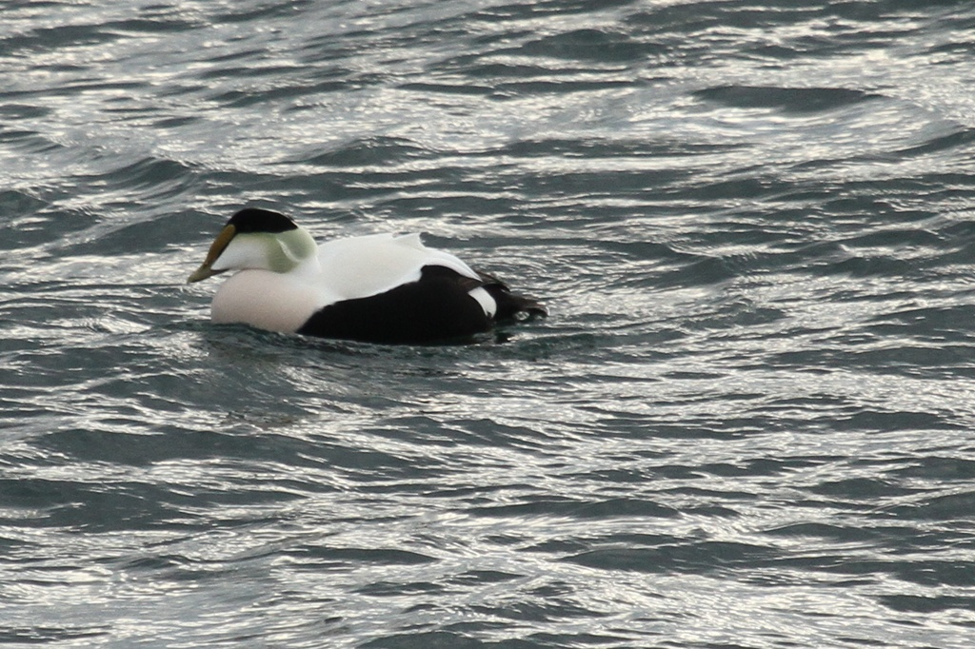
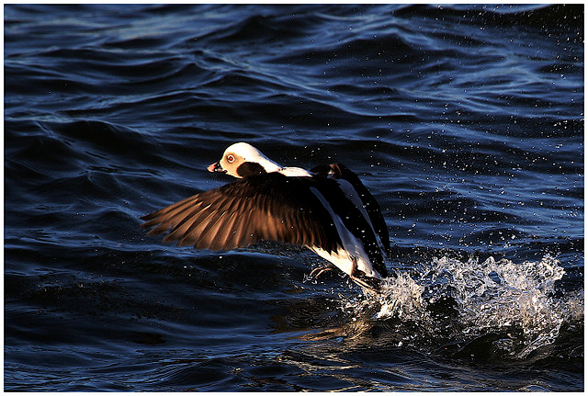
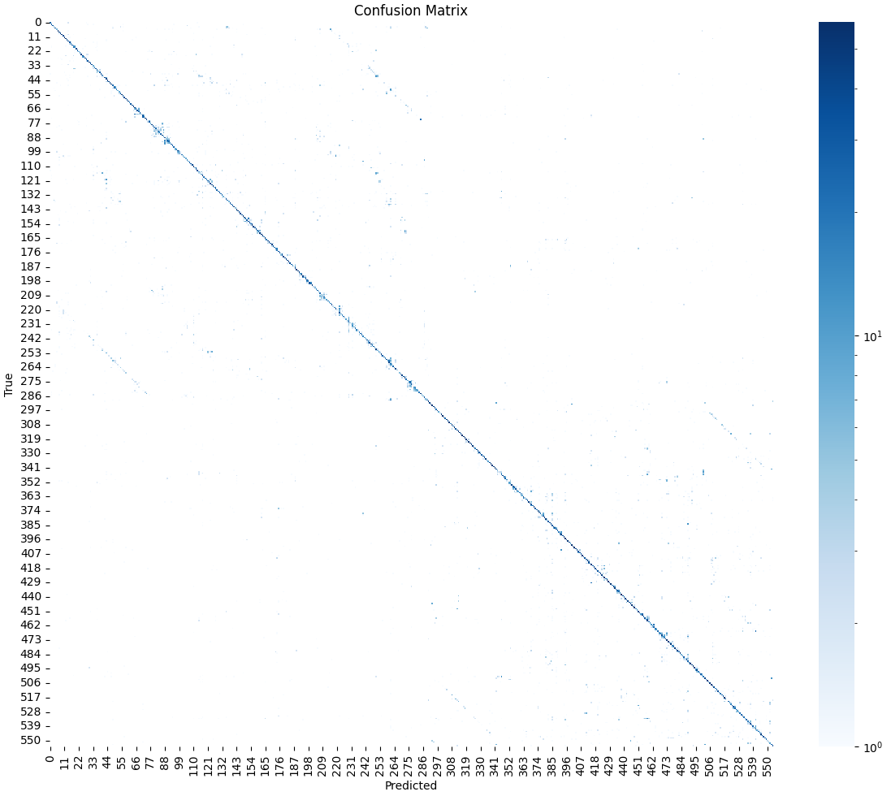
BirdBoy: American Bird Species Classification using Convolutional Neural Networks
Eric Sun | Vincent Allen Sison
Department of Computer Science | Pacific Lutheran University | Tacoma, WA
Introduction
Automatic bird species classification has significant ecological and scientific value, aiding conservation efforts and biodiversity studies. However, bird identification is challenging due to fine-grained differences between species and varied visual environments. Leveraging convolutional neural networks (CNNs) has shown promising results in fine-grained image classification tasks, including bird recognition (Wah et al., 2011; Cui et al., 2018).
Methodology (cont.)
Conclusion
Despite moderate accuracy, the model demonstrates the effectiveness of CNNs in ecological classification tasks. Improvements could involve using attention-based models (Zhao et al., 2021) or combining visual and audio features (Lostanlen et al., 2018).
References
Wah, C., Branson, S., Welinder, P., Perona, P., & Belongie, S. (2011). The Caltech-UCSD Birds-200-2011 Dataset. https://authors.library.caltech.edu/27452/1/CUB_200_2011.pdf
Van Horn, G., Branson, S., Farrell, R., Haber, S., Barry, J., Ipeirotis, P., Perona, P., & Belongie, S. (2015). Building a bird recognition app and large scale dataset with citizen scientists: The fine print in fine-grained dataset collection. CVPR. https://openaccess.thecvf.com/content_cvpr_2015/papers/Van_Horn_Building_a_Bird_2015_CVPR_paper.pdf
Cui, Y., Song, Y., Sun, C., Howard, A., & Belongie, S. (2018). Large Scale Fine-Grained Categorization and Domain-Specific Transfer Learning. CVPR. https://arxiv.org/abs/1806.06193
Zhou, B., Khosla, A., Lapedriza, A., Oliva, A., & Torralba, A. (2016). Learning Deep Features for Discriminative Localization. CVPR. https://arxiv.org/abs/1512.04150
Zhao, B., Wu, X., & Fu, Y. (2021). Hierarchical Feature Embedding for Attribute-Based Recognition. AAAI. https://ojs.aaai.org/index.php/AAAI/article/view/16208
Lostanlen, V., Salamon, J., Farnsworth, A., Kelling, S., & Bello, J. P. (2018). BirdVox-full-night: A dataset and benchmark for avian flight call detection. ICASSP. https://arxiv.org/abs/1807.05812
Dataset
We used the NABirds dataset (Van Horn et al., 2015), which includes over 48,000 images across 555 bird species with hierarchical taxonomy and detailed bounding box annotations. The dataset supports fine-grained recognition tasks and is well-suited for training deep CNNs.
Figure 2: Cropping images based on bounding boxes
Results
Our trained model achieves a top-1 accuracy of ~70% on the NABirds test set. While most of the birds were guessed right, the model had trouble distinguishing between birds of similar likeness.
Figure 1: Example images in dataset.
Methodology
Our model uses ResNet-101 architecture fine-tuned on the NABirds dataset. We incorporate bounding box annotations during preprocessing to focus the model’s attention on the bird, minimizing background noise (Zhou et al., 2016). Key steps include:
Data loading based on train_test_split.txt and bounding_boxes.txt
Bounding box cropping and augmentation (horizontal flip, color jitter)
Training using cross-entropy loss and evaluation with top-1 accuracy
Figure 3: Accuracy confusion matrix.

